Slide 1
Topic :
Growth and Development
Miss S. Rabiya Zahid

Slide 2

Influence Growth and Development
Nature
(Heredity)
Nurture
(Environment)

Slide 3

Types of Developmental Change
Physical
Cognitive
Social
Moral

Slide 4

Physical Development
Growth of body and brain and change or stability in sensory capacities, motor skills, and health.
Cognitive Development
Change or stability in mental abilities, such as learning, thinking, reasoning and creativity.

Slide 5
Moral Development
Age related thoughts, feelings and behaviors regarding rules, principles, and values that guide what people should do.
Social Development
Changes and stability in emotions, personality, and social relationships

Slide 6


Principles of Development
Rates Differ
Orderly
Gradual

Slide 7
Theories of Development

Slide 8

Physical Development
Brain Development
Main structures
Specialization and integration
Storing and transferring information

Slide 9
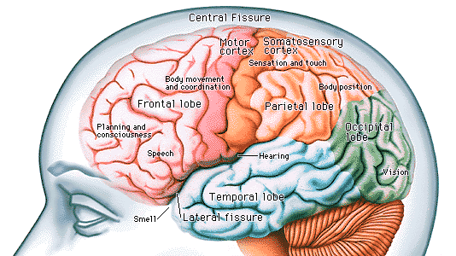
Physical Development

Slide 10
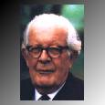

Piaget’s basic assumption
Piaget’s Theory
(Cognitive Psychologist)
Development is
children’s attempts
to make sense
of the world

Slide 11
Piaget’s Theory
Piaget postulates that at different periods, children use different mental structures to think about and make sense of their world. The structures available to children are determined by their biological readiness and life experiences. Piaget thought of children incapable of learning particular tasks if not in that stage.

Slide 12
Piaget’s Theory
Piaget believed that what distinguishes human beings from other animals is our ability to do “abstract symbolic reasoning.”
As a biologist, Piaget was interested in how an organism adapts to its environment (Piaget described this ability as intelligence.)

Slide 13
Piaget’s Theory
Behavior is controlled through mental organizations called schemas that the individual uses to represent the world and designate action.
This adaptation is driven by a biological drive to obtain balance between schemes and the environment (equilibration).

Slide 14
Piaget’s Theory
Piaget described two processes used by the individual in its attempt to adapt:
assimilation and
accommodation.
Both of these processes are used throughout life as the person increasingly adapts to the environment in a more complex manner.

Slide 15
Piaget’s Theory
As schemas become increasingly more complex (i.e., responsible for more complex behaviors) they are termed structures.
As one's structures become more complex, they are organized in a hierarchical manner (i.e., from general to specific).

Slide 16
Cognitive stage Age Range Major Characteristics
Sensorimotor Birth-2years Development of motor
skills, little or no
capacity for symbolic
representation.
Preoperational 2-7years Development of language
and symbolic thinking.
Concrete 7-12 Development of
operational conversation, mastery
of concept of
reversibility.
Formal 12-adulthood Development of logic and
operations abstract thinking.

Slide 17
Lev Vygotsky
sociocultural theory
Lev Vygotsky developed the sociocultural theory of cognitive development.
Vygotsky approached cognitive development from a process of orientation. He looked at the process itself and analyzed the subject's participation in social activities.

Slide 18
Lev Vygotsky
sociocultural theory
Emphasized the child’s interaction with the social world (other people) as a cause of development
Vygotsky believed language to be the foundation for social interaction and thought
Children learn from interactions with other people

Slide 19
Lev Vygotsky
sociocultural theory
  Zone of proximal development
  difference between what a child can do alone
  and with help.
  Critical thinking based on dialogue with others
  who challenge ideas

Slide 20
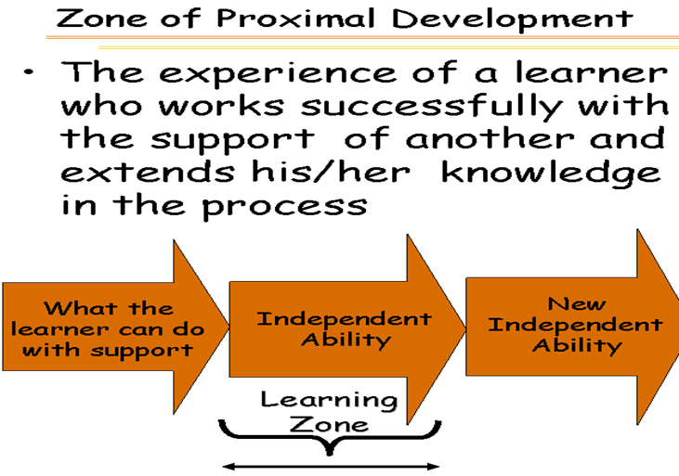

Slide 21
Lev Vygotsky
He proposed that development does not precede socialization. Rather, social structures and social relations lead to the development of mental functions.
He believed that learning could occur through play, formal instruction.

Slide 22
Lev Vygotsky
The basic process by which this occurs is mediation (the connection of two structures, one social and one personally constructed)
It is when the cultural signs become internalized that humans acquire the capacity for higher order thinking.

Slide 23
Lev Vygotsky
A key assumption made by Vygotsky is that during the course of development everything occurs twice.
The child first makes contact with the social environment. This occurs on an interpersonal level.
Then a child makes contact within himself, on an intrapersonal level.

Slide 24
Erikson’s Theory
(Social)
His developmental theory of the "Eight Stages of Man" was unique in that it covered the entire lifespan rather than childhood and adolescent development.
Erikson’s view was that the social environment combined with biological maturation provides each individual with a set of “crises” that must be resolved.

Slide 25
Erikson’s Theory
Adolescence
Identity VS Role confusion
Develops a sense of self in relationship to others and to own internal thoughts and desires
  social identity
  personal identity

Slide 26
Erikson’s Theory
The individual is provided with a "sensitive period" in which to successfully resolve each crisis before a new crisis is presented.
The results of the resolution, whether successful or not, are carried forward to the next crisis and provide the foundation for its resolution.

Slide 27
Erikson’s Stages of
Psychosocial Development
Basic Trust vs. Basic Mistrust
Autonomy vs. Shame/Doubt
Initiative vs. Guilt
Industry vs. Inferiority
Identity vs. Role Confusion
Intimacy vs. Isolation
Generativity vs. Stagnation
Ego Integrity vs. Despair
Notes:
Basic Trust vs. Basic Mistrust
-Birth to 12-18 months: Feeding
-Infant must form a loving, trusting relationship with caregiver
Autonomy vs. Shame/Doubt
-18 mos to 3 years: Toilet training
-Development of physical skills: walking, grasping, potty
Initiative vs. Guilt
-3 to 6 years: Independence
-Child more assertive/initiative but may be too forceful
Industry vs. Inferiority
-6-12 years: School
-Deals with demands to learn new skills or feel incompetent/failure
Identity vs. Role Confusion
-Adolescence: Peer Relationships
-Teen achieves identity in work, gender roles, politics, religion
Intimacy vs. Isolation
-Young Adulthood: Love
-Develops intimate relationships or feels isolated
Generativity vs. Stagnation
-Middle adulthood: Parenting
-Support next generation
Ego Integrity vs. Despair
-Late adulthood: Reflection on life
-Acceptance of oneself, sense of fulfillment

Slide 28
Basic Trust vs. Basic Mistrust
-Birth to 12-18 months: Feeding
-Infant must form a loving, trusting relationship with caregiver
Autonomy vs. Shame/Doubt
-18 mos to 3 years: Toilet training
-Development of physical skills: walking, grasping, potty
Ego Integrity vs. Despair
-Late adulthood: Reflection on life
-Acceptance of oneself, sense of fulfillment

Slide 29
Initiative vs. Guilt
-3 to 6 years: Independence
-Child more assertive/initiative but may be too forceful
Industry vs. Inferiority
-6-12 years: School
-Deals with demands to learn new skills or feel incompetent/failure

Slide 30
Identity vs. Role Confusion
-Adolescence: Peer Relationships
-Teen achieves identity in work, gender roles, politics, religion
Intimacy vs. Isolation
-Young Adulthood: Love
-Develops intimate relationships or feels isolated
Generativity vs. Stagnation
-Middle adulthood: Parenting
-Support next generation

Slide 31
Kohlberg's Theory
(Moral Development)
Kohlberg proposed that moral development progresses from external control to internalized societal standards to personal, principled moral codes.
According to Kohlberg, moral reasoning is based on a developing sense of justice and growing cognitive abilities.

Slide 32
Kohlberg's Theory
(Moral Development)
Kohlberg’s levels
Preconventional Morality
people act under external controls. They obey rules to avoid punishment or reap rewards, or act out of self interest.
Conventional Morality
people internalized the standards of authority figures. They are concerned about being

Slide 33
Kohlberg's Theory
(Moral Development)
“good ” pleasing others, maintaining the social
orders.
Postconventional Morality
people now recognize conflicts between moral standards and make their own judgment on the basis of principles of right, fairness, and justice.

Slide 34
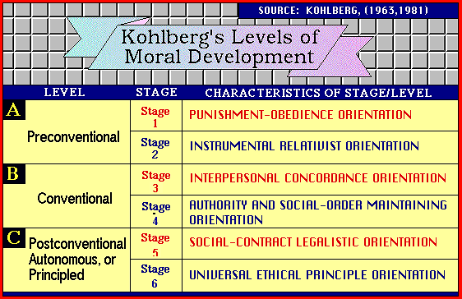

Slide 35
Psychological Development

Slide 36
Psychological Development
The development of human beings' cognitive, emotional, intellectual, moral and social capabilities and functioning over the course of the life span, from infancy through old age.

Slide 37
Psychological Development
Period between birth and the acquisition of language one to two years.
Gain knowledge and learn things through their
senses and inherited reflexes.
e.g. touching, vision, hearing,
Infancy

Slide 38
Psychological Development
Physical interactions with his environment progress from simple uncoordinated reflex movements to more coordinated actions
Solve physical problems by mentally imagining certain events and outcomes
Learn emotional states e.g. surprise, distress, relaxation, and excitement, anger, sadness, and fear.
Infancy

Slide 39
Psychological Development
one or two years of age until the onset of adolescence at age 12 or 13.
Learn use of language
Cognitive abilities; performing logical operations on abstract and symbolic material.
Childhood
Exhibits experimental or goal-directed behavior.

Slide 40
Psychological Development
At this stage child learns the classifications of ideas.
Childhood
Exhibits experimental or Begins to manipulate the environment by means of symbolic thought and language; he becomes capable of solving new types of logical problems and begins to use mental operations.

Slide 41
Psychological Development
Emotionally, children develop self-awareness i.e., awareness of their own emotional states, characteristics, and potential for action.
Childhood
They become increasingly able to discern and interpret the emotions of other people. This contributes to empathy, or the ability to appreciate the feelings and perceptions of others and understand their point of view.

Slide 42
Psychological Development
These new abilities contribute to the child's moral development, they concern over and avoidance of acts that attract pain and punishment and progresses to a more general regulation of conduct so as to maintain parental regard and approval.
Another important thing in moral reasoning is the avoidance of internal guilt and self-recrimination.
Childhood

Slide 43
Psychological Development
Begins at 12 or 13 and culminates at age 19 or 20 in adulthood.
Intellectually, is the period when the individual becomes able to systematically formulate hypotheses or propositions, test them, and make rational evaluations.
Adolescence

Slide 44
Psychological Development
The formal thinking of adolescents and adults tends to be self-consciously deductive, rational, and systematic.
Adolescence
Emotionally, is the time when the individual begins to establish his own role and relationships.

Slide 45
Psychological Development
Its a time when the individual lessens his emotional dependence on his parents and develops a mature set of values and responsible self-direction.
Adolescence

Slide 46
Psychological Development
Adulthood is a period of optimum mental functioning when the individual's intellectual, emotional, and social capabilities are at their peak to meet the demands of career, marriage, and children.
Adulthood

Slide 47
Psychological Development
Some psychologists delineate various periods and transitions in early to middle adulthood that involve crises or reassessments of one's life and result in decisions regarding new commitments or goals.
Adulthood
Its is a period of adjustment between the potentialities of the past and the limitations of the future.

Slide 48
Psychological Development
An emotional rebellion has been observed referred as a mid-life crisis, recognition that less time remains to be lived than has been lived already.
Adulthood
During late middle age individuals become more aware of ill health and thus may consciously or unconsciously alter the patterns of their lives.

Slide 49
Psychological Development
Individuals accept the limits of their accomplishments and either take satisfaction in them or despair and become anxious over unobtained objectives.
Adulthood

Slide 50
Psychological Development
During old age sensory and perceptual skills, muscular strength, and memory tend to diminish, though intelligence does not.
These changes, together with retirement from active employment, tend to make the elderly more dependent on their children or other younger people, both emotionally and physically.
Adulthood

Slide 51
Factors Influences on Development and their Achivement
Physical development
Parental involvement
Parenting styles
Home environment
Socioeconomic status
Ethnicity

Slide 52

Childs personal factors
  Perception
  Self efficacy beliefs
  Academic motivation
  Goals of life

Slide 53
Conclusion
Human beings are coherent wholes, and behavioral development is unified, so that development in any one area of life at any one time is ineluctably interrelated with development in other areas at the same and at other times in patterns of mutual influence.

Slide 54
In the life course, genetic endowment and biology interact with cultural context and experience shape the development of human behavior.
Each of these powerful sources of influence on development has distinctive characteristics, and it is their transaction over time as well as the degree of congruence between the two that influence outcome.

Slide 55
Our elucidation of the processes that underpin human growth is central to understanding normal as well as abnormal development.

Slide 56
So at the end of this discussion all the things are interrelated and effects each other s functioning and make the child and adolescence psychologically week or strong personality. Also helps for understanding the Normal and Abnormal development.

Slide 57
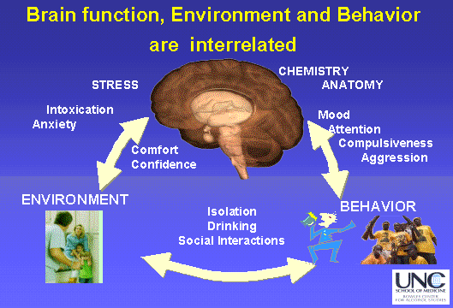

Slide 58
Concept Map for Chapter 2
Language
Development
Development
Defined
Cognitive
Development and
Language
Vygotsky’s Theory
and
Implications
Piaget’s Theory
and
Implications

Slide 60
The End

